Slide 1
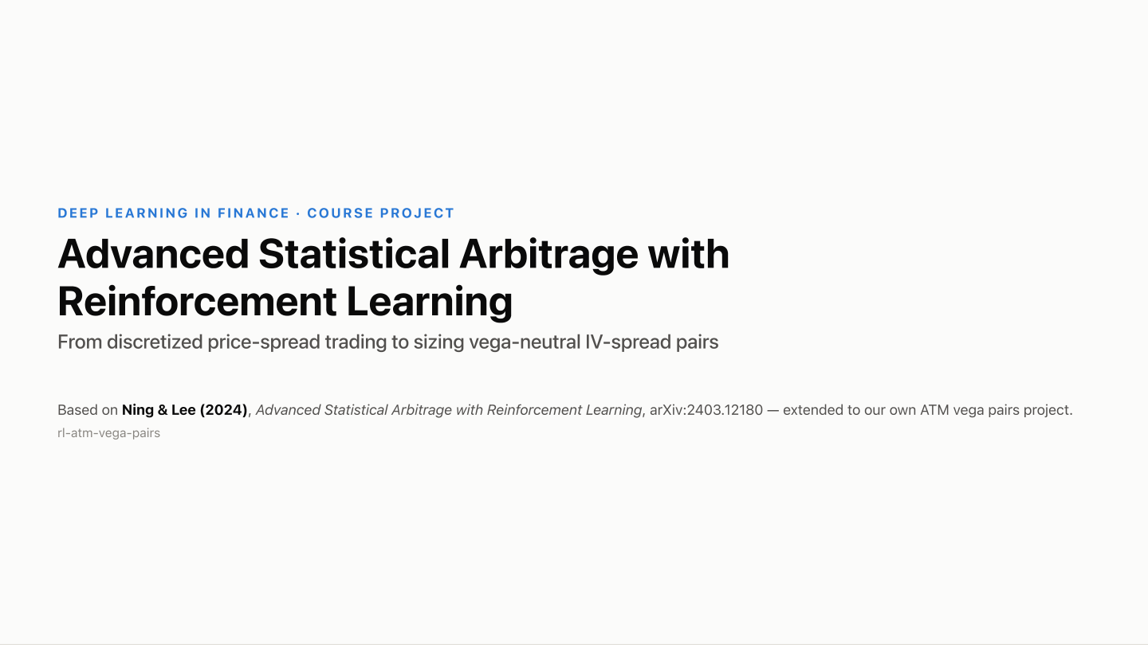

Slide 2
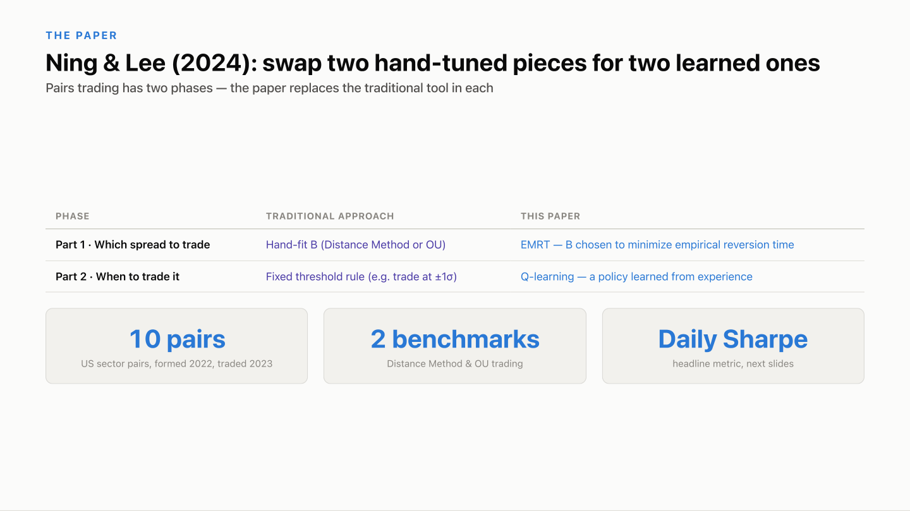

Slide 3
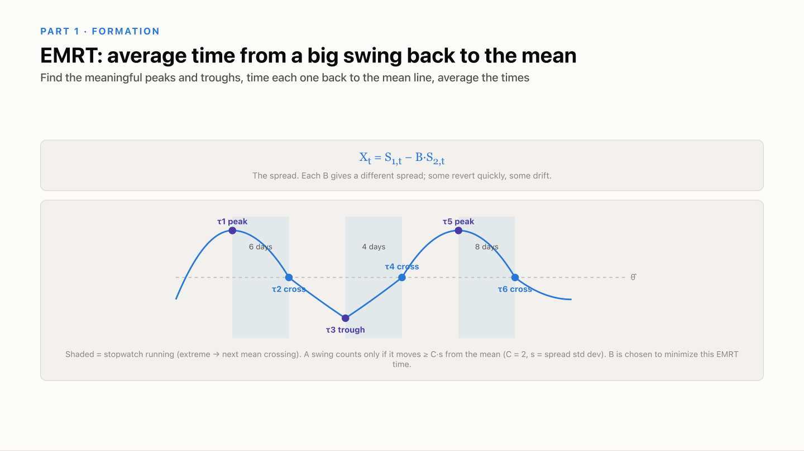

Slide 4
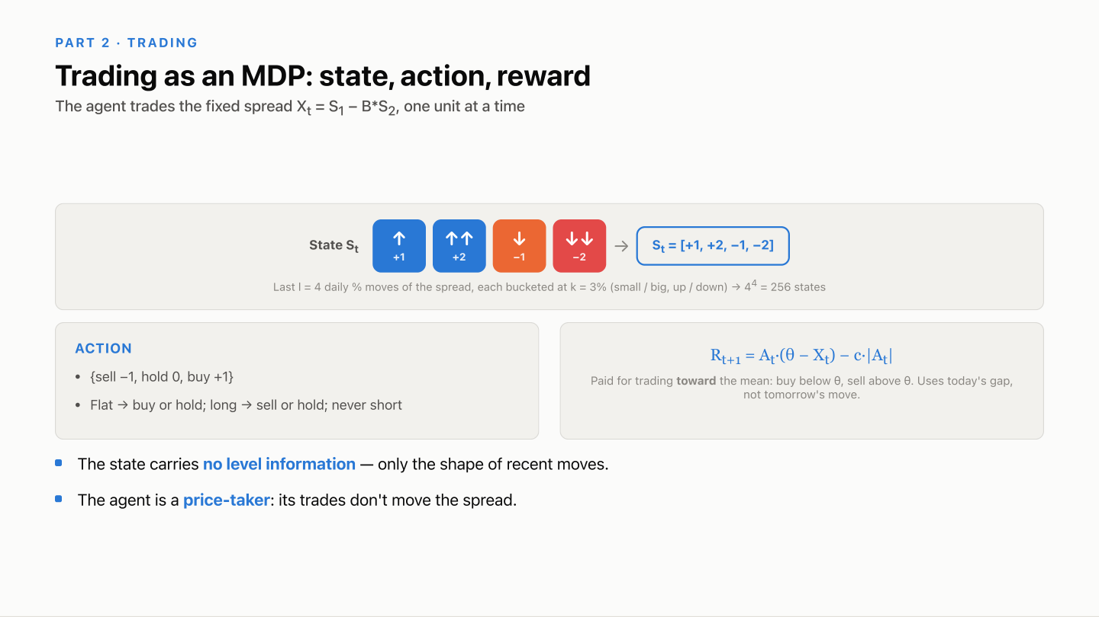

Slide 5
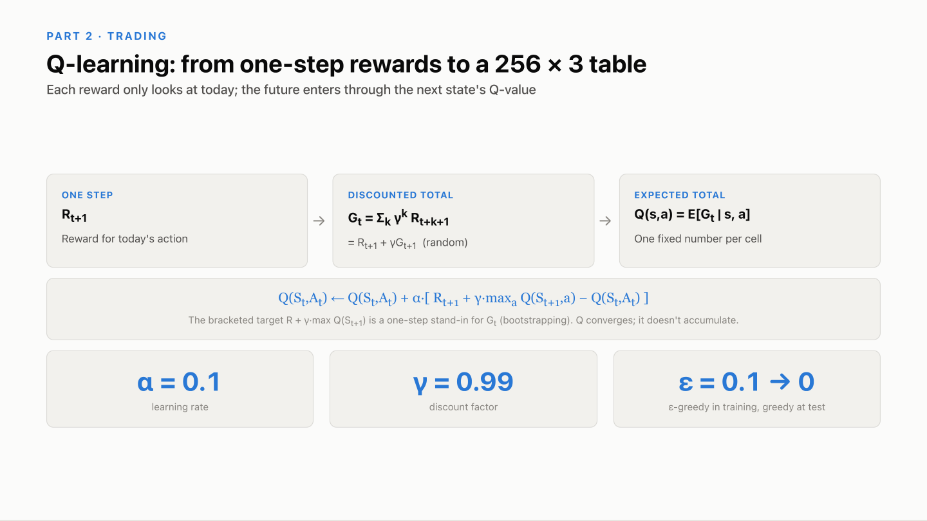

Slide 6
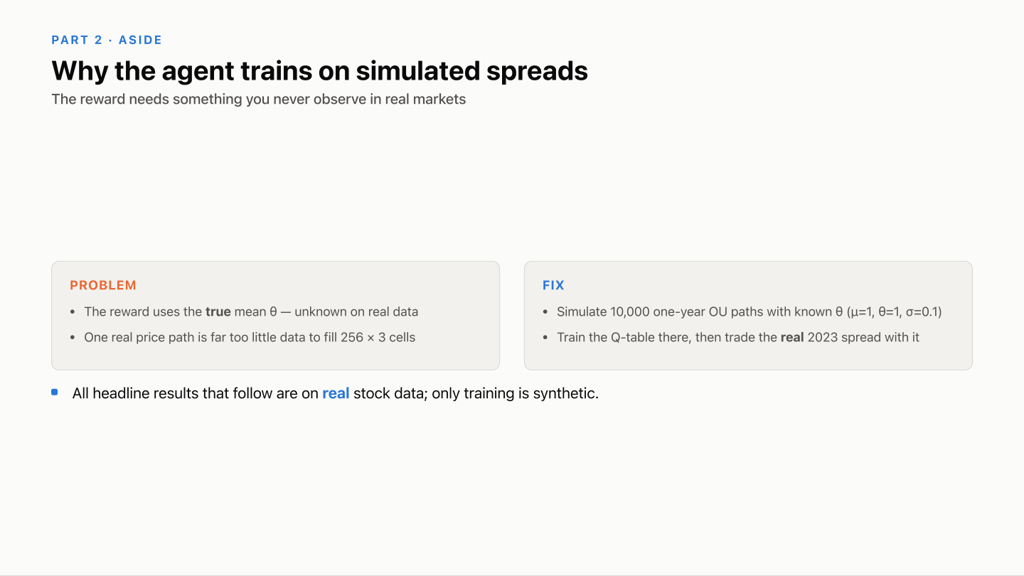

Slide 7
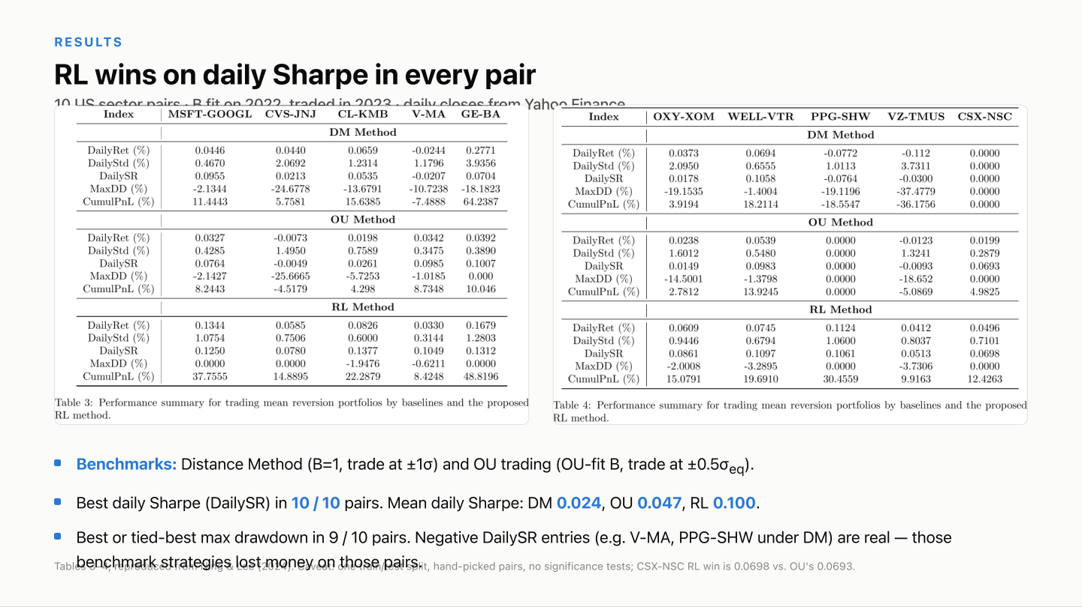

Slide 8
OUR EXTENSION
From equity spreads to volatility spreads
The paper trades deviations in equity prices.
We investigate deviations in option-implied volatility across related stocks.
EQUITY SPREAD
VOLATILITY SIGNAL
LEARNED SIZE
→
→
Price deviations
Which trade looks attractive?
How much should we trade?
Delta-hedged option profitability depends on realized price variation relative to the implied volatility paid or received. We test whether historical relative pricing identifies attractive long/short exposures.
8

Slide 9
OUR EXTENSION
The downside-put signal emerged from exploration
01 START
ATM implied-volatility data → actual option contracts
02 EXPLORE
ATM, downside puts, opposite wings, different maturities
03 RETAIN
Approximately 30-day, 25-delta puts: strongest retained contract result
04 FREEZE
Freeze proposals to isolate the benefit of learned sizing
Also investigated realized variance, historical spreads, profitability memory, and alternative data. Configuration selected after examining results.
9
Notes:
The downside-put strategy emerged from empirical exploration. We subsequently froze its proposals to isolate the benefit of sizing. This is not an untouched holdout.

Slide 10
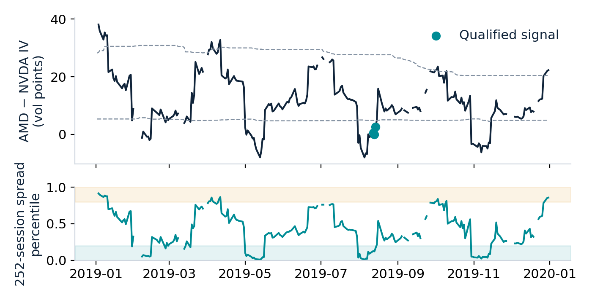
OUR EXTENSION
What actually generates a trade?
1 Rank the pair’s IV spread over the preceding 252 sessions.
2 Bottom ≤20% or top >80%: buy relatively cheap volatility, sell expensive volatility.
3 Beta 0.85–1.15; correlation ≥0.5; positive completed-history directional profitability.
4 Matching puts, initially vega neutral; daily stock delta hedging.
AMD/NVDA example: Aug 12/13 signals → Aug 13/14 executions. Extreme ranks alone do not qualify.
2019 rolling selected-contract IV, not held-cohort marks. At least 63 observations; no missing-quote imputation. Variance-premium features inform size, not entry.
10

Slide 11
OUR EXTENSION
The learner chooses exposure, not the entry signal
STATE
ACTION
OBJECTIVE
Relative IV + rank
Realized vs. implied variance
Profitability memory
Pair + market conditions
50% / 75% / 100%
of the trade’s vega budget
Sharpe of aggregated
historical daily P&L paths
after training costs
→
→
Monthly refit: tree states + direct policy search
Use the preceding 18 months of completed outcomes.
Contextual allocation with direct-Sharpe CEM search. No Bellman update or discounted continuation value; not the paper’s Q-learning.
11
Notes:
This is contextual allocation with direct policy search. Unlike the paper’s Q-learning, it has no Bellman update or discounted continuation value.

Slide 12
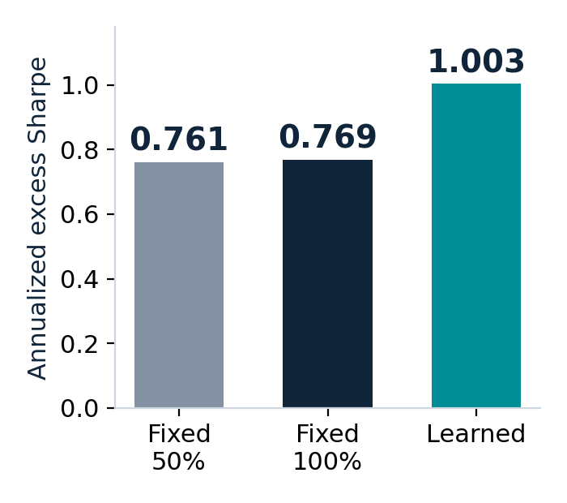
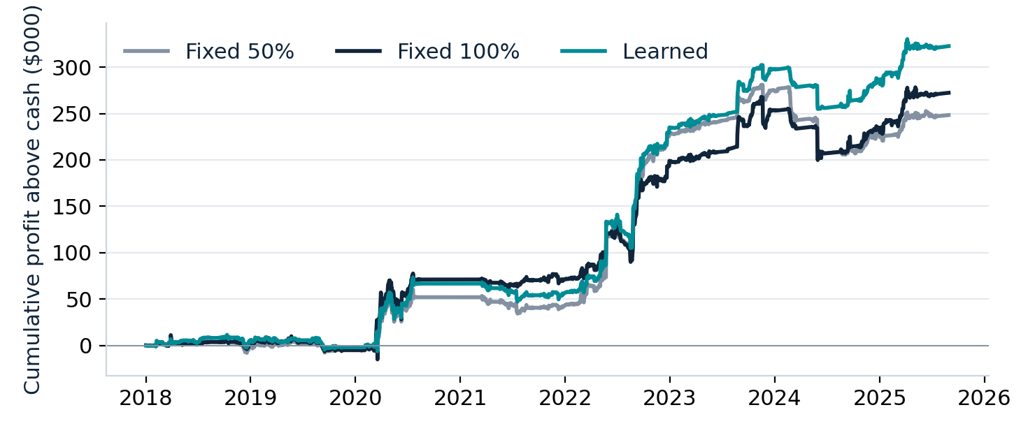
OUR EXTENSION
Learned sizing improves the matched historical comparison
Fixed 50%
Fixed 100%
Learned 50/75/100%
263 entries | $248,315 above cash
133 entries | $272,338 above cash
212 entries | $322,637 above cash
Common proposals; sizing changes overlapping inventory and which trades pass risk limits.
$10m equity · 2018–Aug 2025 · Next-session execution; hold to expiry; $0.03 commission plus 0.1 vol point per leg; daily hedge execution at 1 bp.
12
Notes:
The improvement comes from adaptive exposure and its effect on overlapping inventory and trade admission. These are common proposals, rather than identical executed portfolios. Source: main_sizing_comparison_10m.csv and cumulative_performance_10m.csv. Annualized excess Sharpe uses supplied cash-excess returns, excluding initialization.

Slide 13
OUR EXTENSION
Research progression: recency and variance-premium features
Five-year training window
0.826
18-month training window
0.962
Add variance-premium features
1.006
Shorter history improved adaptation in this experiment.
Added EWMA variance premium, its historical z-score, and realized/implied variance ratios.
Development results: original $345m funding reference; matched $10m result is 1.003. Changes more than sizing. More features and learned skips generally failed to help.
13

Slide 14
OUR EXTENSION
Does the sizing benefit carry into walk-forward evaluation?
INITIAL FIT
MONTHLY REFIT
EVALUATION
Jul 2016–Dec 2017
74 completed examples
Rolling prior 18 months
Completed outcomes only
2018–Aug 2025
Shared funded ledger
PERIOD
FIXED FULL SIZE
LEARNED
Initial pre-2018 training
1.573
2.015
Subsequent walk-forward evaluation
0.769
1.003
Annualized Sharpe; compare within rows. Training: aggregated paths, $0.65 commission. Evaluation: funded ledger, $0.03 commission. History previously researched.
14
Notes:
Training improvement is expected; subsequent performance is the more relevant evidence. Walk-forward fitting is causal, but retrospective pair selection and repeated research remain. Source: sources/initial_train_walk_forward.csv.

Slide 15
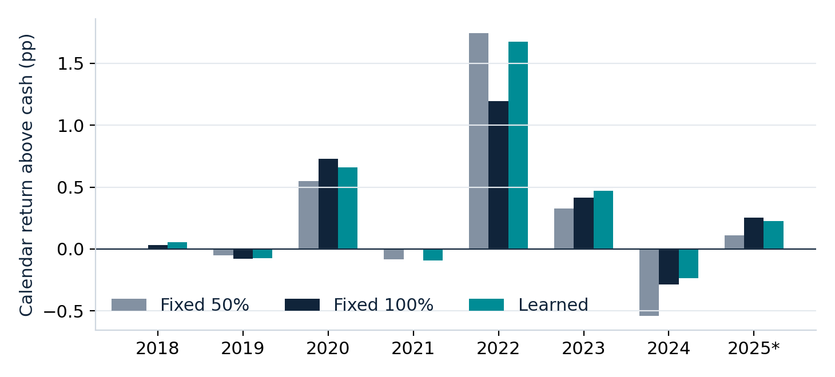
OUR EXTENSION
Adaptive sizing helps—but the evidence has limits
The retained signal earns money with fixed sizing.
Learned allocation reaches approximately one excess Sharpe.
Gains vary across regimes, including losing years.
Repeated research and concentrated event profits limit the conclusion.
Next: freeze and prospectively validate the strategy with prospective pair selection. Combine independently validated signals and learn allocations using signal strength, correlations, inventory, and capital usage.
“Adaptive sizing improved the historical risk-adjusted performance
of the retained options strategy relative to constant exposure.”
*2025 through Aug 29; final signals June 30, followed by runoff. Bars show calendar return above cash, in percentage points.
15
Notes:
Main result is 1.003. Do not substitute the separate 1.029 management checkpoint. Fitted-Q, native one-year, portfolio combinations and older ATM neural-network comparisons belong in an appendix once their source results are supplied.

Slide 16
EXTENSIONS
Learn when to reduce or exit positions
Entry sizing answers how much to trade. Management adds how long to retain the risk.
Update IV, expected realized variance, spread convergence, and remaining inventory.
Hold, reduce both legs, or close both legs; execute next session with costs.
STRATEGY
HOLD TO EXPIRY
LEARNED MANAGEMENT
30-day puts
1.003
1.029
Six-month puts
0.592
0.610
Management produced modest historical gains.
Six-month: fitted Q-learning. 30-day: direct policy search.
Historical Sharpe results supplied for this extension; distinct experiments and algorithms.
16
Notes:
Results supplied by the user: 30-day hold-to-expiry 1.003 vs management 1.029; six-month 0.592 vs 0.610. These are not the main matched sizing curves. No source ledger for these extensions was included in slide_chart_inputs.zip.

Slide 17
EXTENSIONS
Develop a separate one-year signal
Match the variance forecast to the longer contract horizon.
Use multiple historical variance measures; compare forecast variance with option-implied variance to determine pair direction. Freeze direction, then learn participation and size.
ONE-YEAR POLICY
SHARPE
Forecast signal, fixed 50% exposure
0.254
Same learned skips, fixed 50% exposure
0.273
Forecast signal, learned sizing
0.313
Forecasting improved the entry signal; sizing added a smaller, statistically uncertain gain.
Learning direction and sizing together performed poorly. Historical results supplied for this separate extension.
17
Notes:
Results supplied by the user. The 0.254 / 0.273 / 0.313 rows separate fixed exposure, learned skips, and learned sizing. Statistical uncertainty is the user-provided characterization; no fresh significance calculation was performed. No numerical forecast-only versus prior-signal comparison was supplied.

Slide 18
EXTENSIONS
Combine independently developed strategies
Strong individual strategies do not automatically produce a stronger portfolio.
Diversification depends on return correlations, shared exposures, and changing regimes. Compare equal weights with allocations estimated from prior performance.
PORTFOLIO
EQUAL WEIGHTS
PRIOR-DATA ALLOCATION*
30-day + six-month
1.029
0.990
30-day + six-month + one-year
1.006
0.865
Adaptive weighting has not yet beaten simple allocation.
Hindsight-optimized three-strategy blend: 1.107 — exploratory upper reference.
*24-month trailing estimates; quarterly reallocation. Full evaluation period. Historical Sharpe results supplied for this extension.
18
Notes:
Results supplied by the user. Hindsight optimization is exploratory and not a deployable prior-data allocation result. No new portfolio optimization or backtest was performed.

Slide 19
NEXT RESEARCH STEP
Next extension: RL for portfolio construction
Keep each signal’s trade proposals fixed. Learn how to allocate across them.
STATE
Signal strength, completed profitability, correlations, inventory, shared names, capital
ACTIONS
Allocate across strategies; admit, reduce, or close positions
OBJECTIVE
Portfolio risk-adjusted performance after execution costs and financing
Benchmarks: equal allocation, risk-based allocation, independent trade-level sizing.
Validation: frozen signals; subsequent data; one shared account and identical constraints.
“Our current evidence supports adaptive sizing within a defined volatility strategy.
The next challenge is learning how independently validated signals should share capital.”
19
Notes:
Proposed future research, not an implemented or validated portfolio RL result. Freeze signal proposals and use one shared account with identical costs, financing, and constraints across benchmarks.

